Slide 1
UVic Workspace Management System
CSC 375
Jay Milishia
Jacob Sun
James Djeric
Jasraj Taneja
Ryan Fang
Notes:
Jacob
Hi everyone, our project is about a scheduling system available for uvic students called UVic workplace management system

Slide 2
Project Ideas
UVic students often struggle to find ideal study spaces
Limited number of online reservation applications supported by UVic
Many empty classrooms are not utilized
Notes:
Jacob
Throughout out the years, UVic students find it difficult to find ideal study spaces, they are either too loud or crowded. It is one of the main reason why we want to develop this. The only application available in UVic is the library study room reservation. Not many choices for students. In addition, a lot of the classrooms are not used when there are no classes. People often find their study space at a corner of a building

Slide 3
Project Proposal
Develop a workplace scheduling system that can accomplish the following
Provide real-time availability of classrooms, computer labs, and libraries
Users can view and search available workplaces for reservations
Allow only UVic student to reserve and extend the usage of workplaces
Users’ reservation data contributes to update workplace availability
Navigate users to the reserved workplace
Send users notifications before the session starts
Users can choose how and when the notifications are sent
Notes:
Jacob
We want to achieve the following for our scheduling application. First, the application can provide real-time availability of classrooms, labs and libraries. Students can also view and search the available workplaces with their corresponding equipment information.
Then, only UVic students can reserve and extend workplaces. Their reservation data will also contribute to update the workplace availability.
Third, the app can navigate users to the reserved workplace if they are unsure
The last key feature is that users can receive notifications before the session starts, which reminds them to cancel the session if they are no longer available. Users can also customize how and when the notifications are sent

Slide 4
Potential Value to Business
It can be used as a template for future space reservation applications.
Other universities can quickly integrate the application to their system with minor modification to the database.
System owners are able to improve the current workplaces based on the collected workplace utilization data.
Notes:
Jacob

Slide 5
Analysis Methodology & Requirement
Conduct surveys to understand student needs
Define requirements using use cases and user stories
Create Data Flow Diagrams (DFD):
Domain Models
Gane and Sarson symbols
Notes:
Jacob
To gather, define, and visualize user requirements, we have decided to do the following.

Slide 6
Requirements Representation
Gathered functional and non-functional requirements
Organized requirements into categories such as search and booking etc.
Prioritized requirements based on business needs
Requirements documented using IEEE Std 830 template
Notes:
Jacob

Slide 7
Data Flow Diagrams
Context Diagram
Level 0 Diagram (Diagram 0)
Level 1 Diagrams (Diagram 1)
Workplace Information Management
Workplace Reservation
Navigation
Usage Report
Account Management
Notes:
Ryan

Slide 8
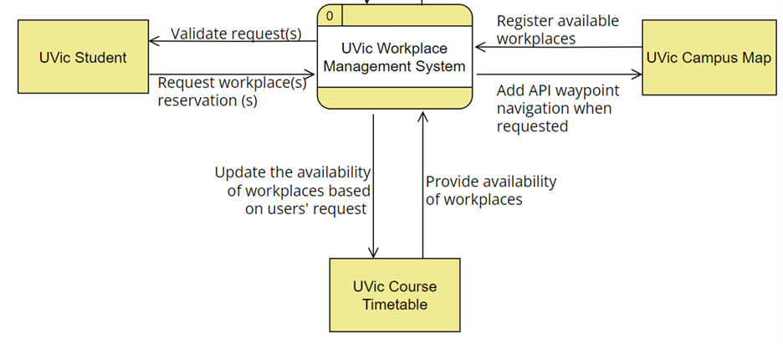
Context Diagram
Notes:
Ryan

Slide 9
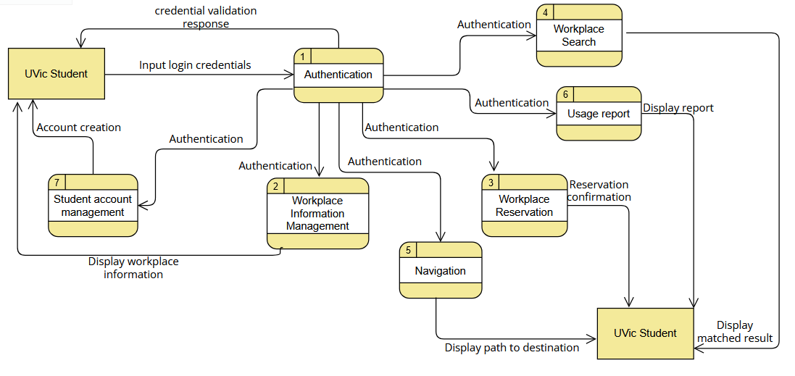
Diagram 0
Notes:
Jay
The diagram is a flowchart that represents a system for managing student records. It starts with the input of student information, followed by the authentication process, which verifies the user's identity. The flowchart then proceeds to the authorization process, where the system checks if the user has the necessary permissions to access the student records.
If the user is authorized, the system then retrieves the student records and displays them on the screen. The flowchart also includes a "new option" that could be used to add or modify student records. The diagram is a visual representation of the steps involved in managing student records, ensuring that the system is secure and user-friendly.

Slide 10
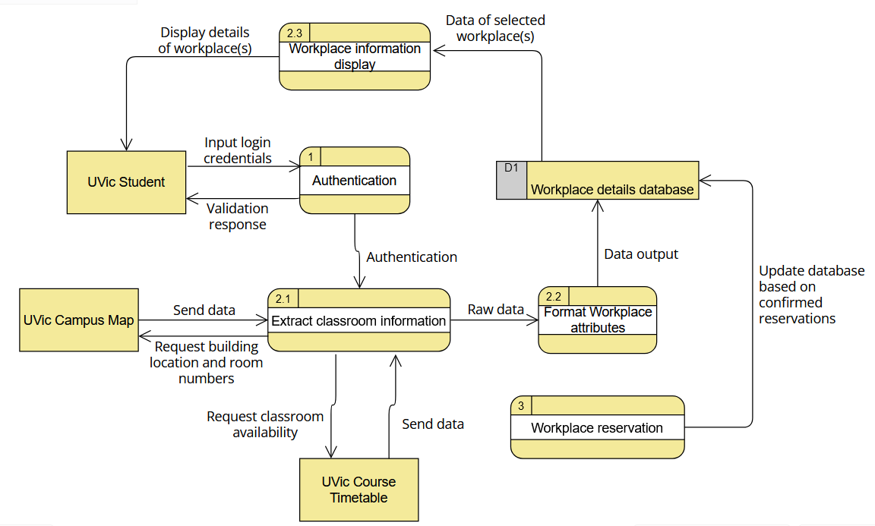
Diagram 1 - Workplace Information Management
Notes:
Ryan

Slide 11
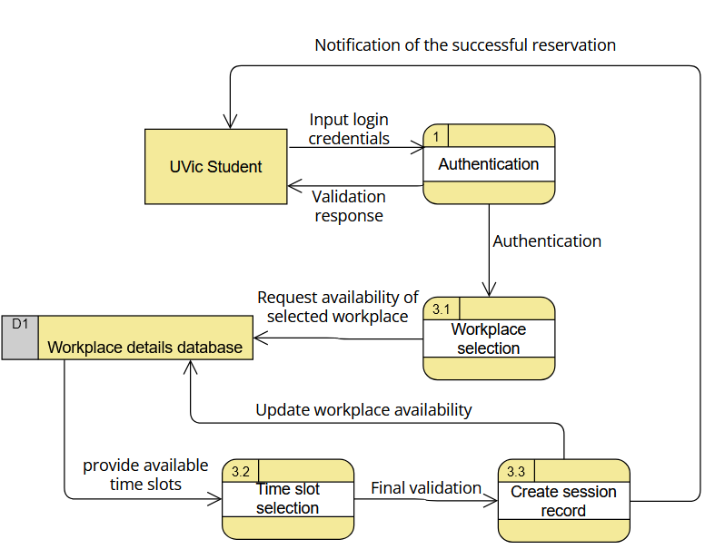
Diagram 1 - Workplace reservation
Notes:
Jay
The image is a diagram illustrating the process of workplace reservation. It shows a step-by-step flowchart of the reservation process, starting from the initial request to the final confirmation. The diagram is divided into several sections, each representing a specific step in the process.
The first step involves the user making a reservation request, which is then followed by the system checking the availability of the requested workplace. If the workplace is available, the system proceeds to validate the user's identity and authenticate the request. Once the validation is successful, the system updates the workplace availability and sends a confirmation message to the user.

Slide 12
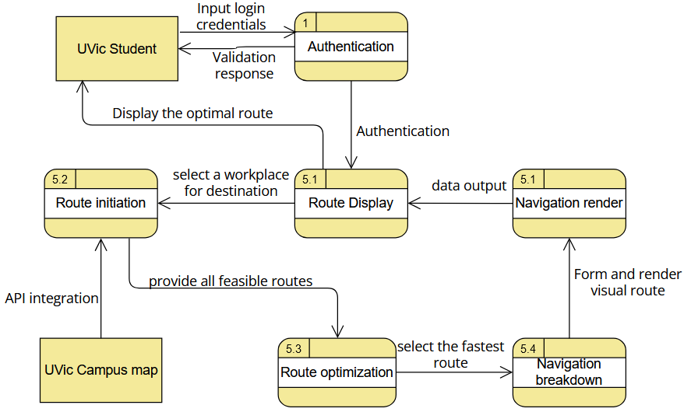
Diagram 1 - Navigation
Notes:
Ryan

Slide 13
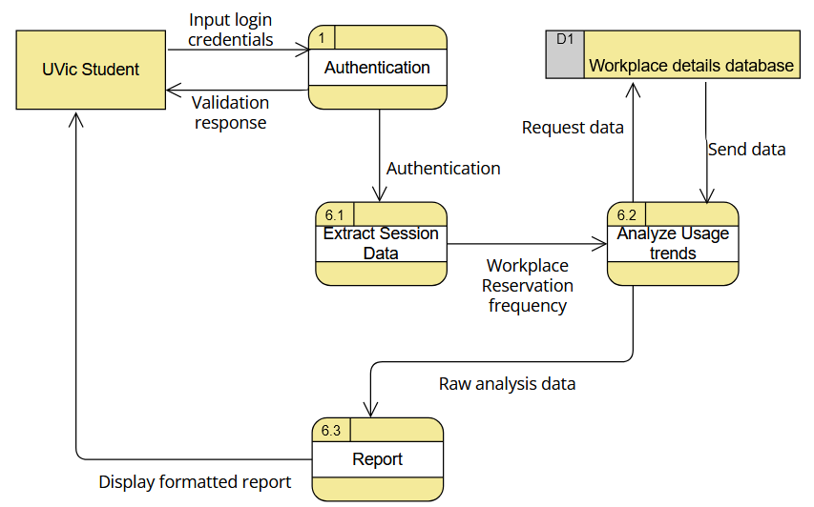
Diagram 1 - Usage Report
Notes:
Jay The image is a diagram illustrating the usage report for a student authentication system. The diagram is divided into several sections, each representing a different aspect of the system.
In the top left corner, there is a box labeled "UVIC Student," which indicates the target user of the system. The diagram then proceeds to show the various steps involved in the authentication process.
There are several boxes and arrows connecting them, representing different actions and interactions within the system. The boxes are labeled with various terms such as "Workforce Data," "Student Response," "Authorization," "Workforce Details," and "Raw Analytics Data." These labels provide context to the different components of the system.
The diagram is a visual representation of the authentication process, helping users understand the flow of information and actions within the system.

Slide 14
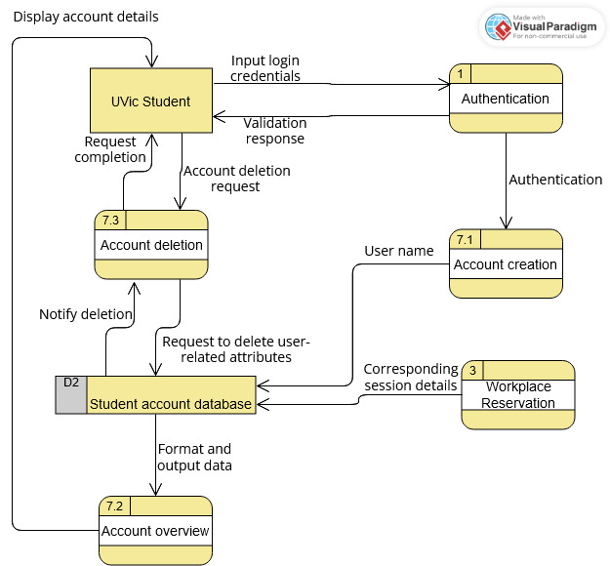
Diagram 1 - Account Management
Notes:
Ryan

Slide 15
UI Design
Login Page
Home Page
View planned sessions (update planned sessions)
Show navigation
Rate & review
View ratings
Reservation Page
Search workplaces
Reserve a session (in details)
Settings Page
Reservation reminders
User information
Navigation settings
Workplace preferences
Notes:
Jas

Slide 16
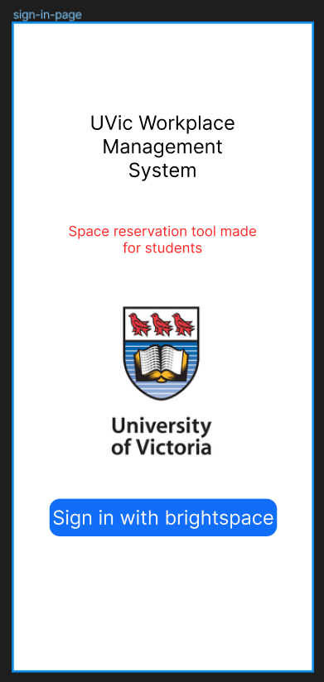
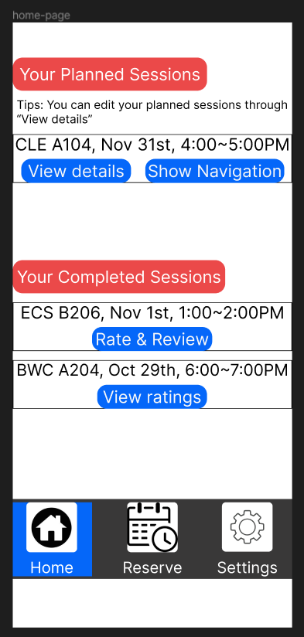
Login page
Home page
Notes:
Jas

Slide 17
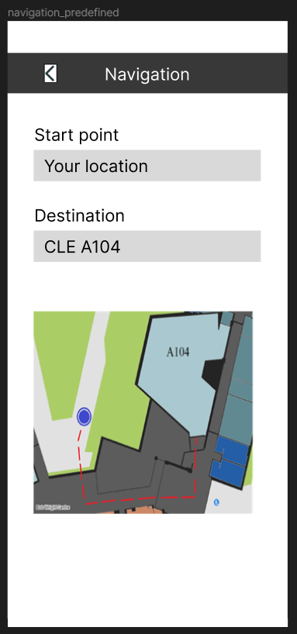
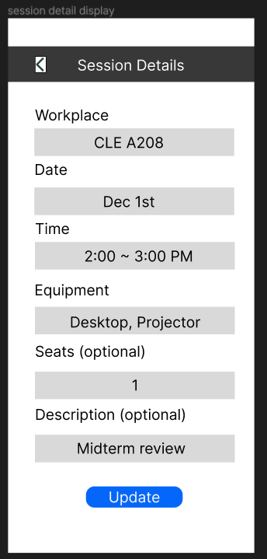
Home page
Show Navigation
View Details
Notes:
Jas

Slide 18
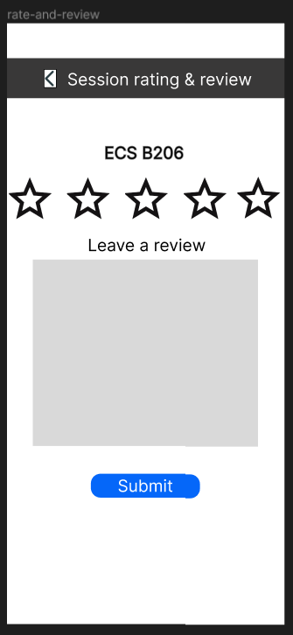
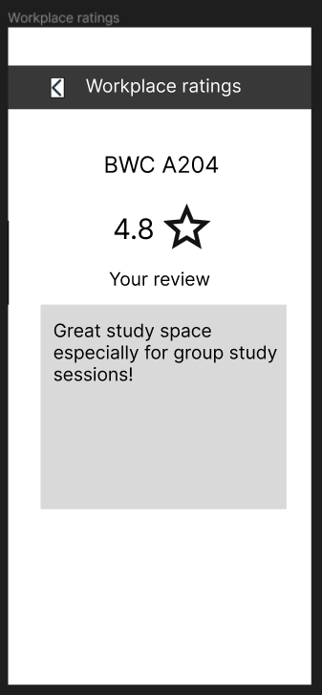
Home page
Rate & Review
View ratings
Notes:
Jas

Slide 19
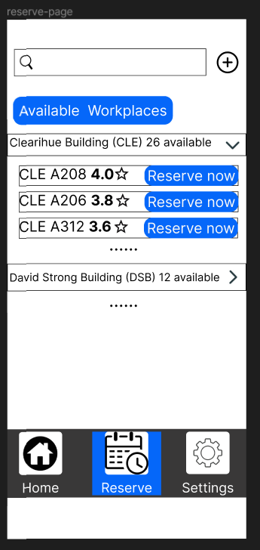
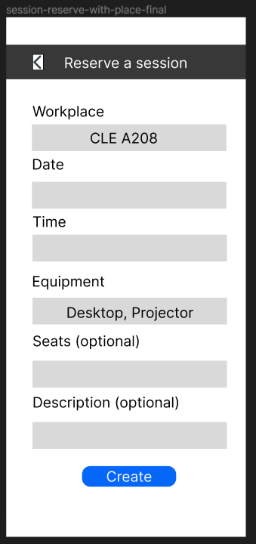
Reservation page
Reserve now
Notes:
James

Slide 20
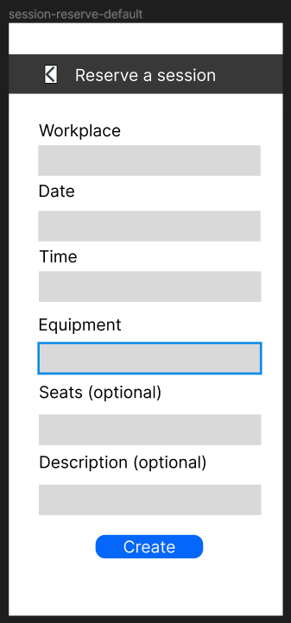
Reservation page
Reserve a session (default)
Notes:
James

Slide 21
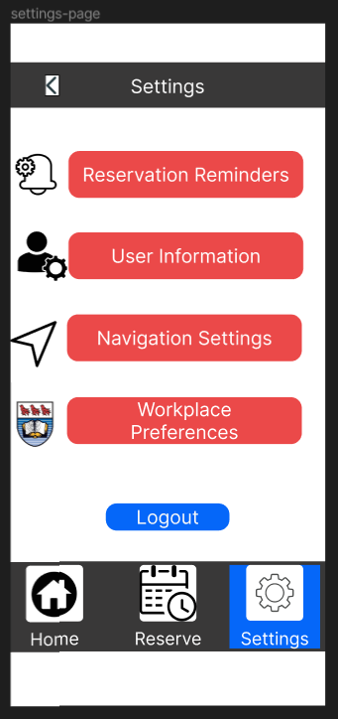
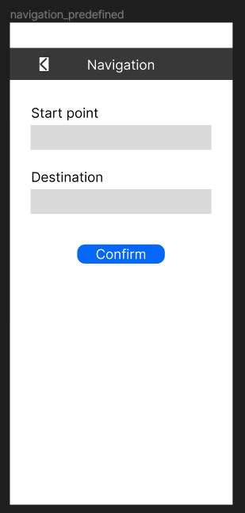
Settings page
Navigation Settings
Notes:
James

Slide 22
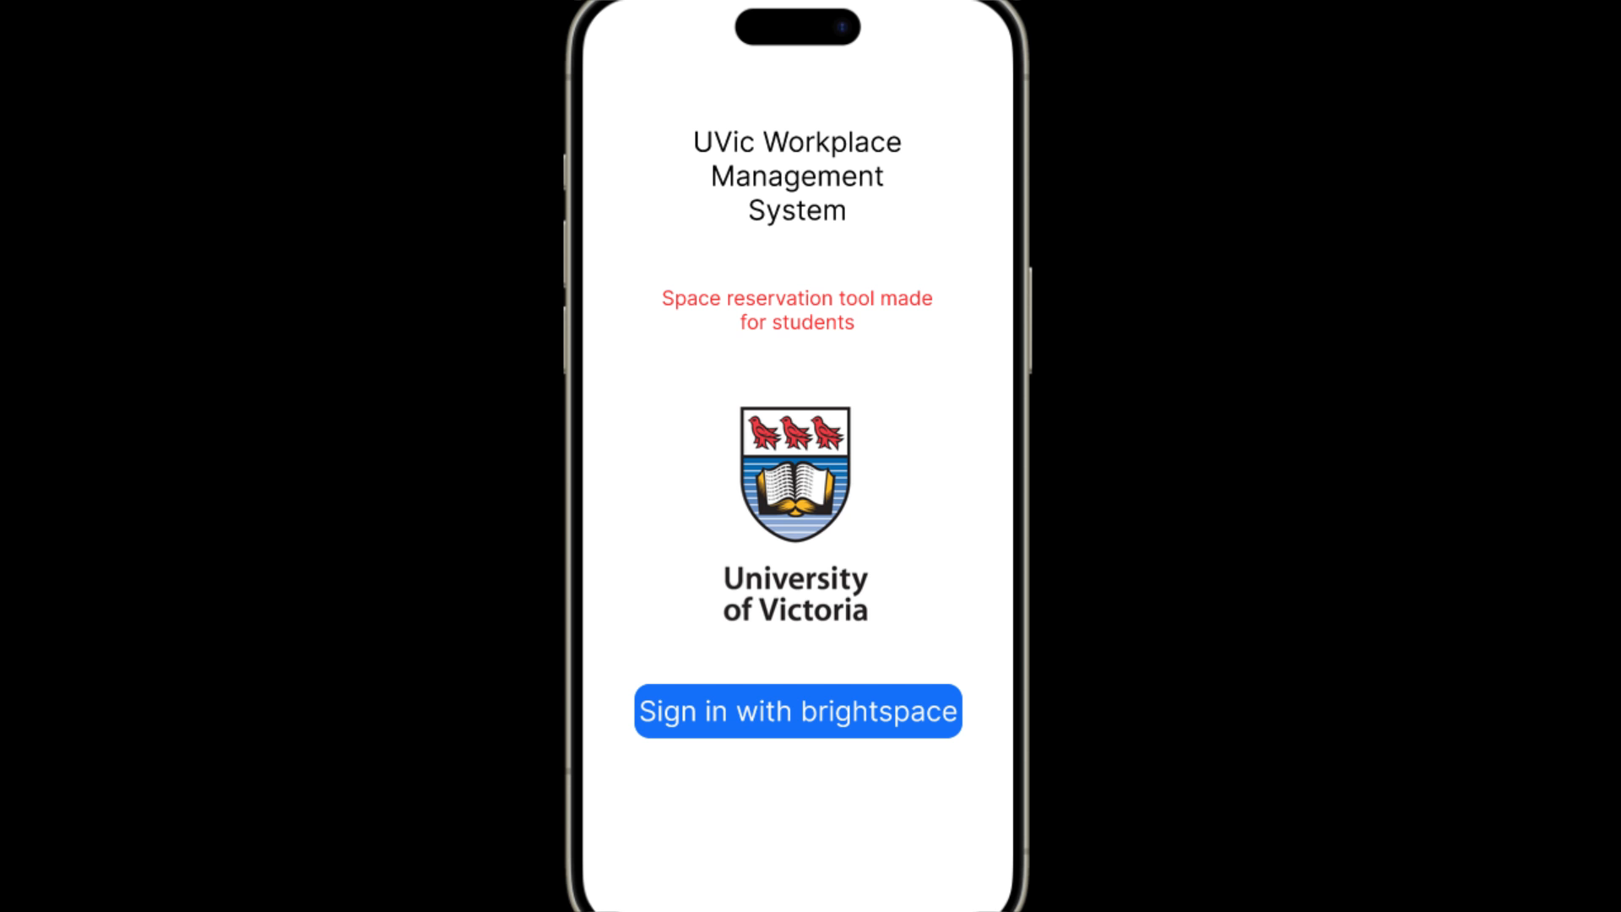
UI Demo

Slide 23
The End
Questions?

